Slide 1

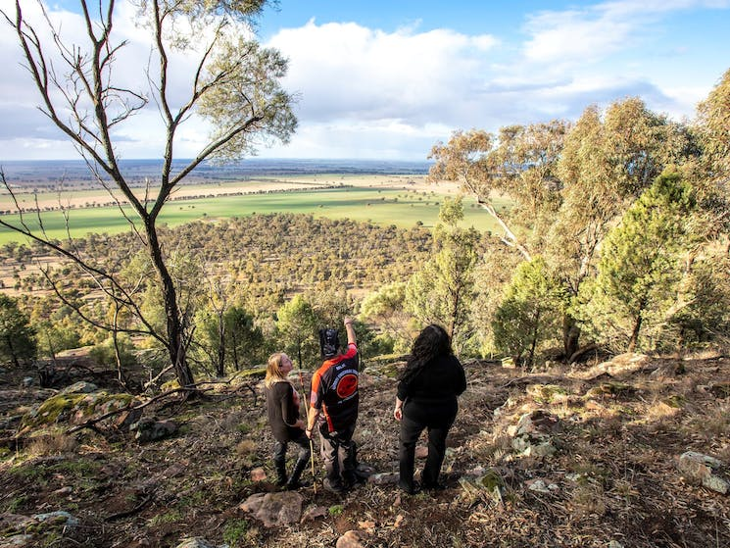
AusIndustry
Regional Precincts & Partnerships
AusIndustry & RDA-Riverina joint presentation
AusIndustry supports businesses to grow, diversify and thrive through a range of government programs and services. We connect business with the right advice, networks, opportunities and funding to help build business

Slide 2

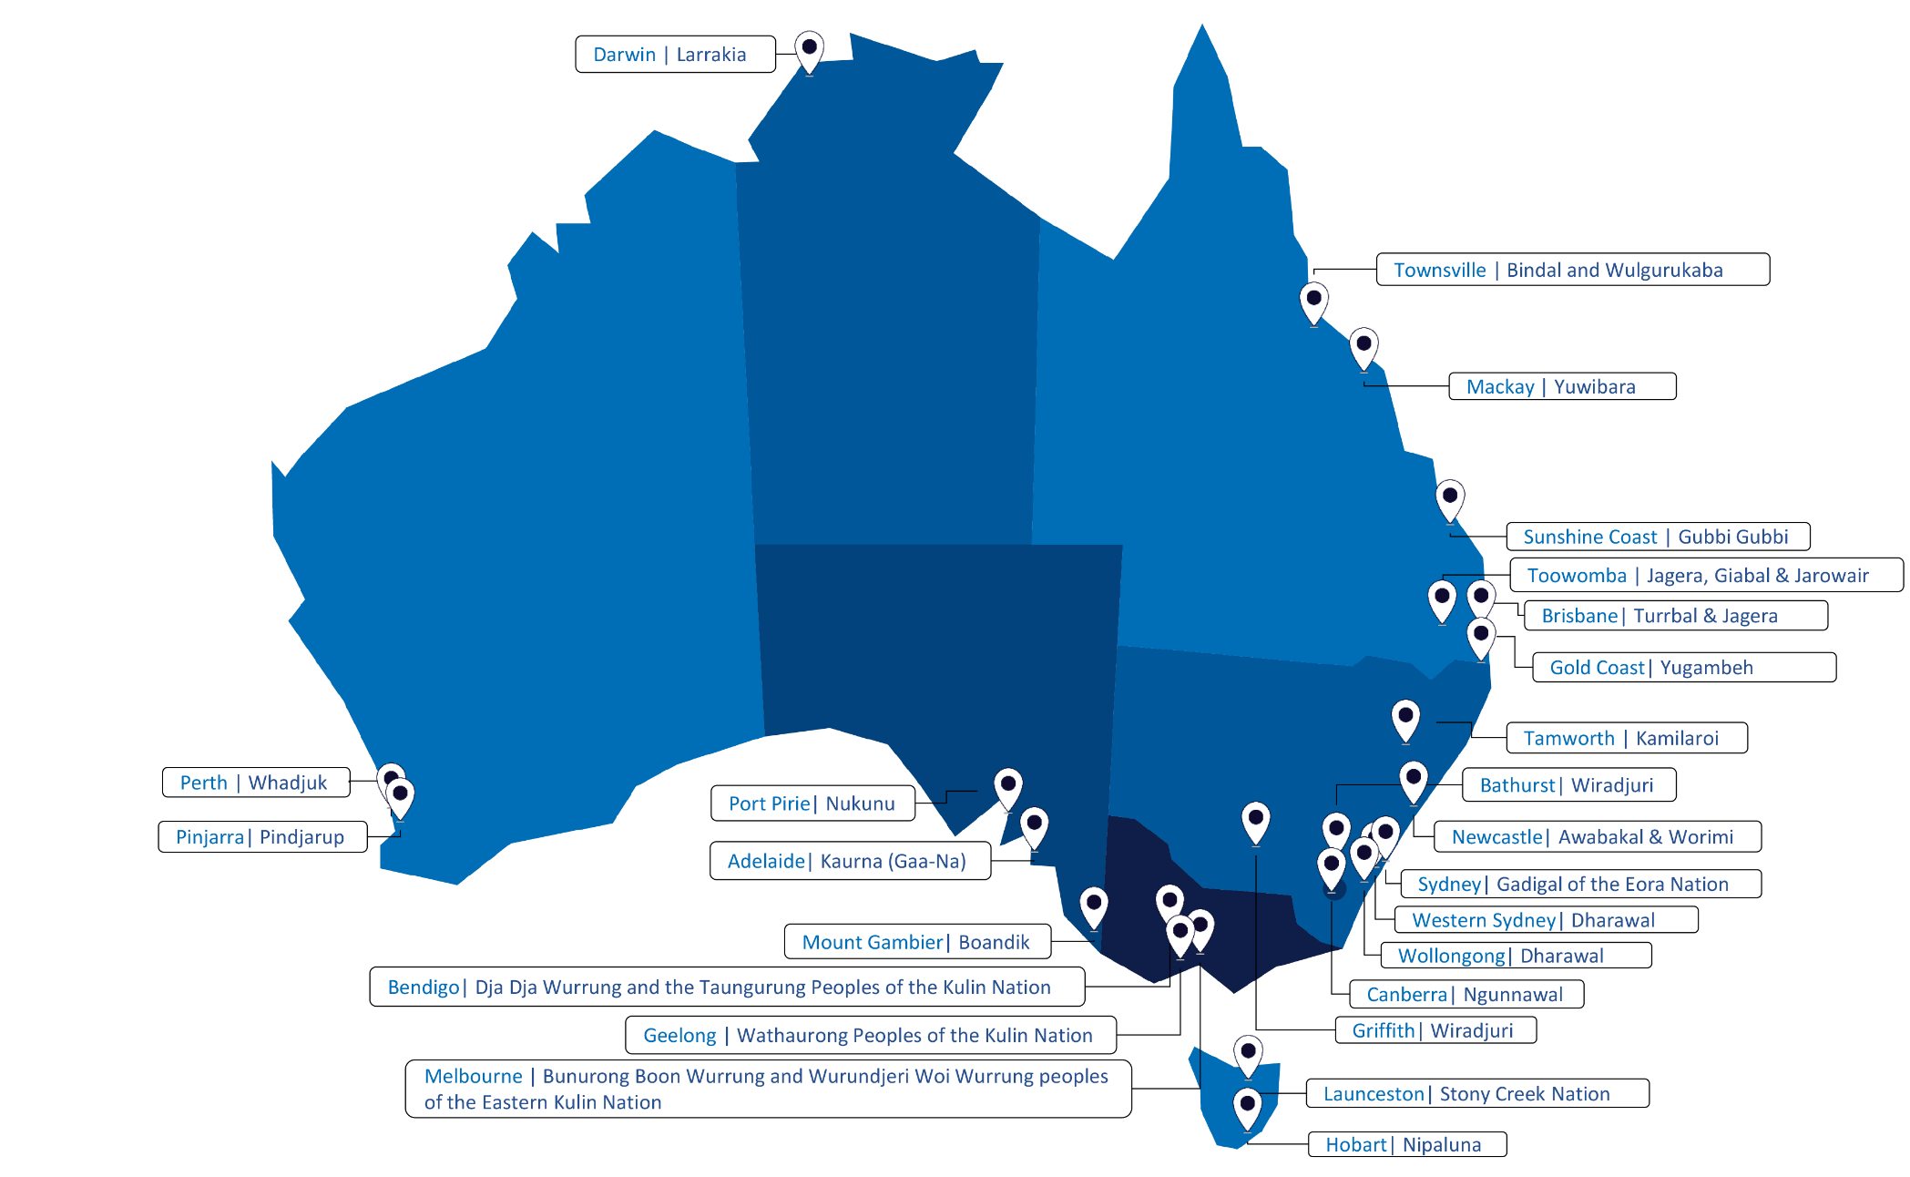

Slide 3

Regional Precincts & Partnerships Program
$400m announced as part of the 2023-24 October Budget, over the next 3 years and reflects the government’s regional investment framework.
1 in 4 infrastructure programmes (Growing Regions, Urban Precincts & Partnerships and Thriving Suburbs program and the Regional Precincts & Partnerships Program.
Objective of the program - is to “facilitate place-based approaches to planning, characterised by collaborative partnerships engaged in sharing design, stewardship and accountability. Provide targeted benefits related to productivity, equity and resilience, Support community priorities and reflect government approach to regional investment.
Purpose- to deliver transformative investment in remote, rural and regional Australia based on unifying regional places, growing economies and serving communities.
3

Slide 4

Regional Precincts & Partnerships - objectives
Demonstrate the value of partnerships between governments, communities and businesses for effective planning, coordination and delivery of infrastructure.
Develop and deliver regional precincts that provide productivity, equity and resilience benefits.
Contribute to government priorities eg: Closing the Gap, transition to Net Zero Economy, Emission Reduction, Social & Affordable Housing & National Cultural Policy.
Notes:
In addition to the outcomes, the broad intent of the programme is to deliver grants across a broad geographical spread of regional Australia, including to remote and very remote areas to support precinct projects of different scales and functionality, and to encourage projects from lesser resources applicants.

Slide 5

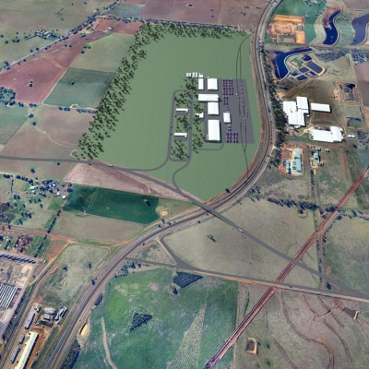
Precincts
User-defined, geographic areas with a specific shared need or theme
Could be:
Business Districts
Neighbourhoods
Activity Centres
Commercial Hubs
Community & Recreation areas
Precincts can be located in regional cities and centres, regional corridors and smaller hubs serving as service hubs.
Grants awarded via non-competitive, merit-based funding rounds. Rounds generally occur twice a year and may differ in focus, industry sector and priority area
Major difference to this program is partnerships…
To meet the Partnerships eligibility:
Must have a governance structure showing who is in the partnership listing the roles and responsibilities, how the partnership works.
Partnerships will need to be confirmed in formal documentation as part of the application process.
Notes:
The partnership approach is designed to bring together governments and communities to plan and deliver regional precincts that are well considered, tailored to local needs and have a shared vision in how that precinct connects to the region.
The programme allows governments and communities to establish long term partnerships and jointly invest in regional priorities with shared stewardship and accountability.
Other local stakeholders also include First Nations groups, Regional Development Australia committees, private enterprise, land owners, developers, designers and end users and community groups.

Slide 6

Who can apply?
To be eligible you must:
have an Australian Business Number (ABN) or Office of the Registrar of Indigenous Organisations (ORIC) registration
and be one of the following entities:
an Australian State/Territory Government agency or body
an Australian local government agency or body as defined in section 14
a Regional University which may be for-profit as defined in section 14
an incorporated not-for-profit organisation. As a not-for-profit organisation you must demonstrate your not-for-profit status through one of the following:
  current Australian Charities and Not-for-profits Commission’s (ACNC) Registration
  state or territory incorporated association status
  constitutional documents and/or Articles of Association that demonstrate the not-for-profit character of the organisation.

Slide 7

Stream 1
Stream2
Two streams
Stream one- the project is considered to be the development of a plan for an entire precinct, even if the applicant is only considering a future investment in a small part of it. Stream one takes a precinct idea through to invest-ready stage.
Stream two – considered to be the construction of one or more elements of a precinct. It is assumed that all the planning, design and scoping has already been completed and the project will be construct ready with approvals in place or imminent. This fund will not construct all elements of the precinct, but to fund enabling infrastructure such as roads, pathways and infrastructure, or specific buildings that might complement or be the catalyst for investment from partners or private enterprise in other elements of the precinct.
Need to be really ready….
Stream 1
Supports planning and development of precincts.
$500,000 - $5m
Stream 2
Supports the delivery of construction.
$5m - $50m
Notes:
Applicants must have the authority to use the land or infrastructure in which they will undertake the project and provide evidence of that authority. Provide evidence of engagement with State and local government and RDA and Traditional Owners. A completed precinct must have a business case, master plan or similar.
Stream Two - The intended outcomes of the grant opportunity are to:
deliver project/s that form part of a precinct or foundational infrastructure that activates a precinct
support the delivery of regional precincts that are tailored to their local contexts and based on a shared vision.

Slide 8
Assessment Criteria
Applicants need a 50% score across all criteria to be meritorious
Assessment Criteria
Criteria is the same for both streams but with different weighting
No. | Criteria | Stream 1 | Stream 2
1 | Alignment with program objectives and government priorities | 35% | 25%
2 | Project need | 35% | 20%
3 | Community Engagement, collaboration and partnership | 20% | 20%
4 | Capacity, capability and resources to deliver the project | 10% | 35%

Slide 9
Criteria Indicators
Criterion One Alignment with plans, priorities and strategies Supports a place-based approach Provides economic opportunities Enhances productivity, equity and resilience Considers climate and energy impacts Contributes to achieving government priorities | Criterion Two Address public infrastructure gaps Deliver improvements in public benefits / services Need for investment and barriers to investment Rationale for individual precinct elements and link to place with purpose Potential future opportunities for investment and expansion | Criterion Three Engagement with local community Use of local knowledge to leverage opportunities and address challenges Partnership based on values of shared design, stewardship and accountability Governance arrangements that support community engagement and collaboration Involvement of First Nations group in design, planning and delivery | Criterion Two Track record managing similar projects Access to skilled personnel Experience in project planning and managing timeframes, budget and risk Project Resource Plan including costings Partner contributions to the project Sound funding strategy Adherence to Government procurement requirements Support beyond the grant term Readiness to commence
Notes:
Assessment criterion 1
Project alignment with program objectives and Australian Government priorities (25 points).
You should demonstrate this through identifying how your proposal:
aims to align with regional plans, community priorities and other regional investment strategies and activities
supports a place-based approach to planning, including better integration of land use and regional development and/or renewal
provides economic opportunities, and enhances productivity, equity and resilience
considers and/or or measures climate and energy impacts such as disaster risk, emissions reduction, biodiversity, decarbonisation, circular economies, and energy and water efficiency
contributes to the achievement of Australian Government policy priorities and program objectives, including but not limited to Closing the Gap, transition to a net zero economy, Australia’s emission reduction goals, social and affordable housing, and National Cultural Policy, relative to the type of project being considered.
Project Need (20 points).
You should demonstrate this through identifying:
how your proposal will address an existing public infrastructure gap and how the precinct, or expansion upon an existing precinct is likely to result in improvements and public benefits in your region
evidence as to why investment in the proposal is needed, including any barriers preventing investment to date
rationale for the elements of the precinct and how these would link a place with a purpose
identification of potential future opportunities for additional private investment in the precinct and/or surrounding region that can build upon the project and help stimulate further expansion, in order to ensure the longevity of the precinct.
Assessment criterion 3
Community engagement, collaboration and partnership (20 points).
You should demonstrate this through identifying:
how your precinct was supported by local knowledge, evidence and information and how it has identified and leveraged opportunities to address challenges within the region
how your partnership members and links with relevant stakeholders will work together to achieve the project based on the values of shared design, stewardship and accountability of planned outcomes
the governance arrangements of the partnership and how they will support, enhance or achieve community engagement and collaboration for the project
how First Nations groups will be involved to help shape the project and influence a stronger outcome that incorporates First Nations experiences, culture and design.
Assessment criterion 4
Capacity, capability and resources to deliver the project (35 points).
You should demonstrate this by:
your proven track record of success in delivering similar initiatives or other public infrastructure projects and your sound project planning experience to manage and monitor the project. This should address scope, implementation methodology, timeframes, consultation, budget and risk management
the business or governance structure and how you will adhere to Commonwealth procurement requirements including the use of First Nations employment and suppliers where possible
the total contributions the grant will leverage from all partners by providing the precinct funding strategy
the level of continued support and capacity to extend the project outcomes beyond the term of funding
your readiness to commence the project with appropriate business case, approvals, land use rights, community support and completed engagement/consultation and all relevant legislative requirements in place.

Slide 10
Expert panel
Regional Precincts & Partnerships BGA
Department of Infrastructure rPPP
The Grant Portal
All eligible applications will be assessed by an expert panel comprised of members from the Urban Policy Forum with expertise from regional development, urban design and renewal.
Applicants deemed meritorious by the expert panel will be reviewed by the Department of Infrastructure.
The panel intends to meet twice a year, this will be dependent on the volume and quality of applications received and may be reviewed.

Slide 11

Regional Precincts and Partnerships Program
Contact us…. RDA Riverina can help you to:
  Access data and statistics to support your application through our Research Officer Melanie Renkin research@rdariverina.org.au
  Access our support for finding partners, or developing precinct ideas,
  Linking to regional plans, RIF, regional strategic priorities,
  Checking eligibility, and
  letters of support - email:
    Amanda manager@rdariverina.org.au or
    Rachel ceo@rdariverina.org.au
How can your RDA help?
Delete the network graphic if too distracting over the photo.

Slide 12


Please engage with your RDA - Riverina
NSW Government
Read the guidelines
Align the project with the objectives
Thank you!
Nicola James & Rachel Whiting
AusIndustry
Business Outreach
News

